Slide 1

ENERGY INNOVATION; IMPORTANCE IN ACHIEVING NET ZERO
A presentation by

Slide 2

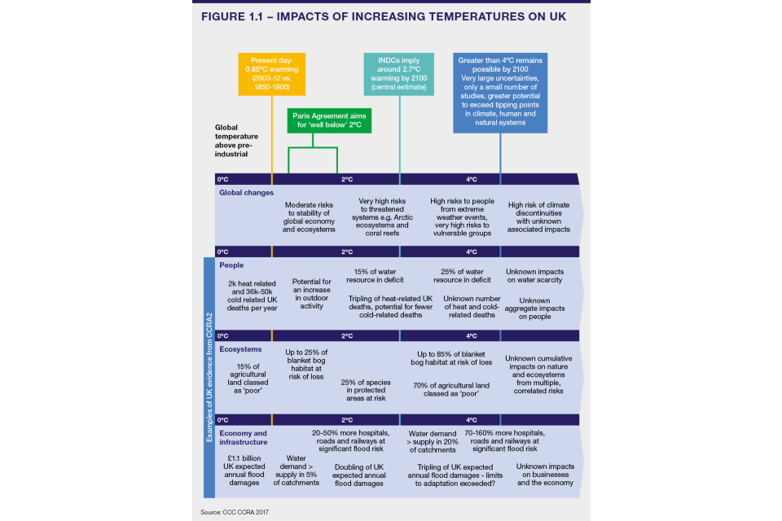
The problem
The UK has experienced its top 10 warmest years since 2002, while Scotland's rainfall has increased by 10% since the early 20th century.
Extreme heatwaves, like the deadly 2003 European summer heatwave, will become more frequent in the UK by the 2040s if current warming rates persist.

Slide 3
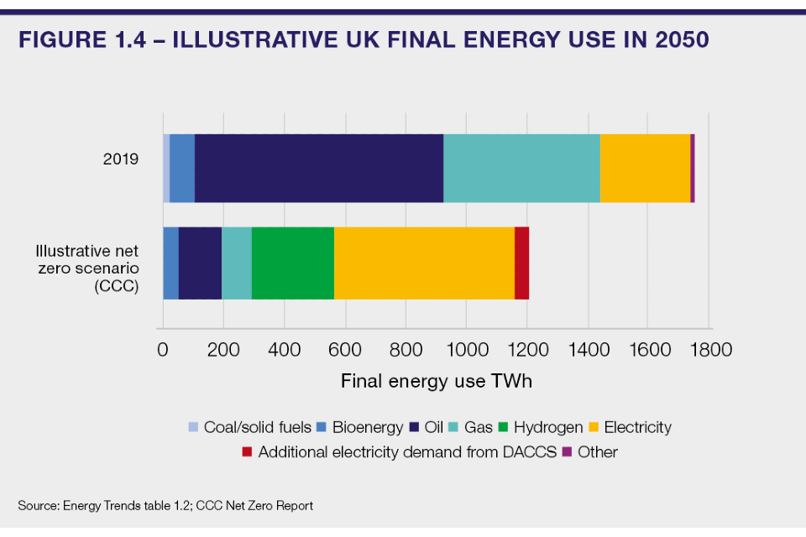
The goal
To deliver energy reliably while ensuring fair and affordable costs, accelerating our transition to clean energy and enabling a smarter, more flexible energy system, which harnesses the power of competition and innovation to the full. ,

Slide 4
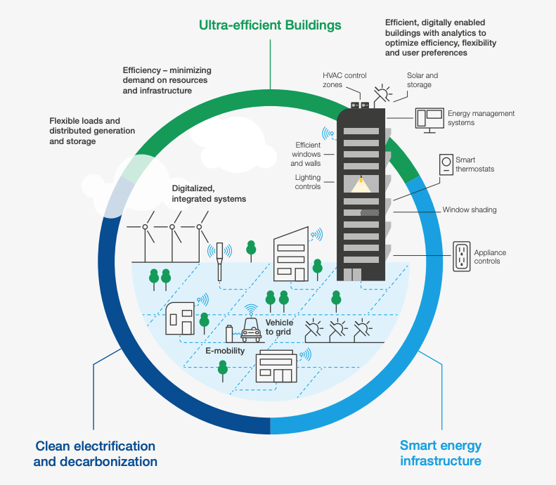
The Solution; importance of energy innovation
Developing and deploying new technologies that reduce greenhouse gas emissions.
Increase energy efficiency across various sectors, including transportation, buildings, and industry; advancements in renewable energy technologies.
Innovations in energy storage systems.
Carbon capture and storage technologies can help mitigate emissions from industries that are challenging to decarbonise.
Reduction in overall energy demand and minimising carbon emissions in the UK.

Slide 5
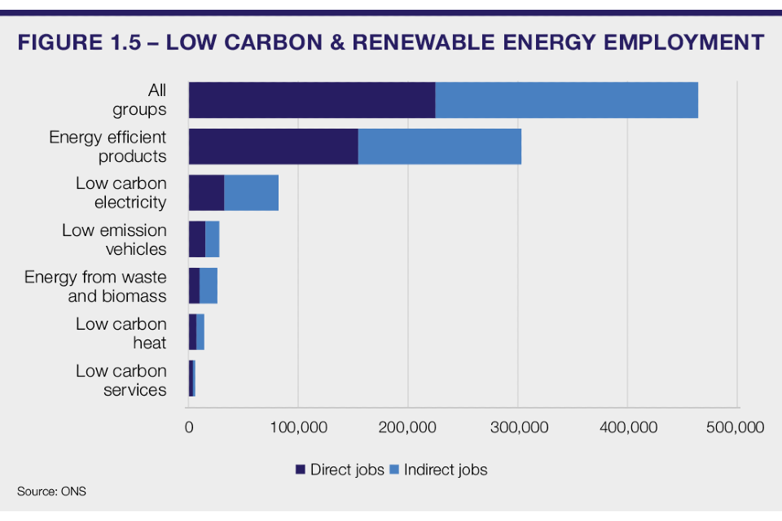
Energy innovation; importance to government
Growth of renewable energy sources.
Reducing greenhouse gas emissions.
Mitigating the impacts of climate change.
Economic growth (creating new industries) and job creation.
Sustainable development and enhancing energy security for the nation.

Slide 6
THANK YOU FOR LISTENING

